Slide 1

Transport & Geography Commission
https://igu-transport.org
IGU Transport & Geography Commission’s business meeting
– Everyone’s welcome!
July 19, 2022
Paris

Slide 2
Transport & Geography Commission
https://igu-transport.org
PROGRAMME
Steering Committee Membership
Commission membership
Reviewing 2022 main activities (so far)
T&G Commission Travel Grants giving (by A. Goetz)
Perspectives for 2023 onwards
Book Series: Transport, Mobilities & Spatial Change (by R. Knowles)
Any other business

Slide 3
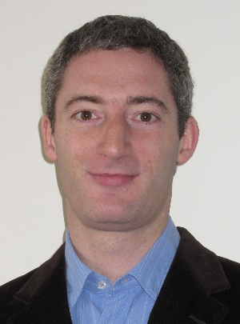
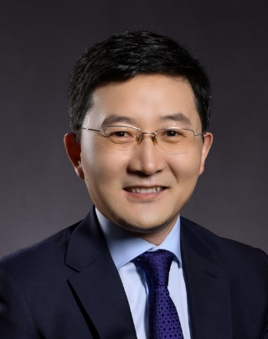
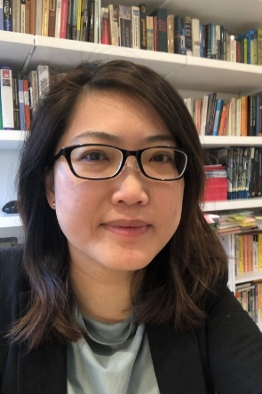
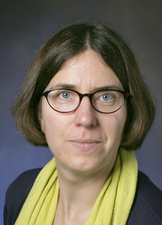
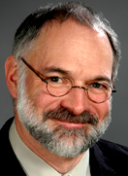
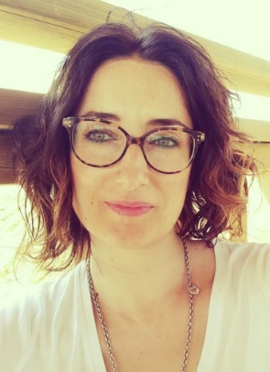
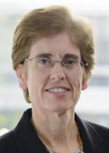
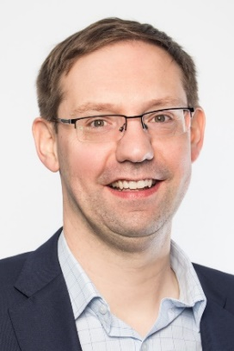
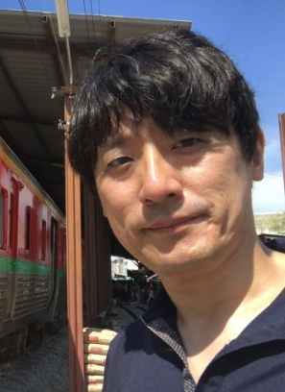
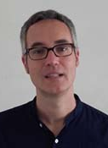
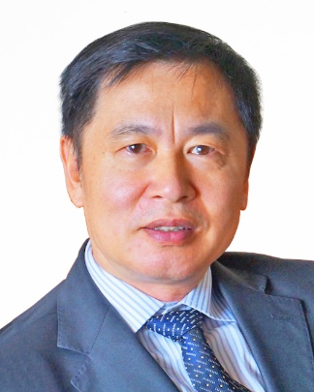

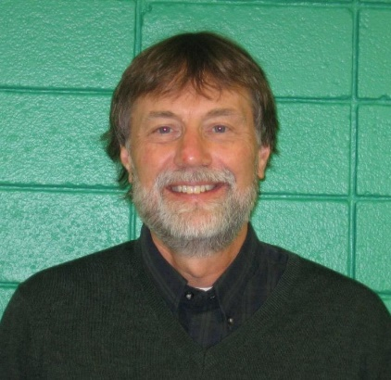
1. Steering committee (2020-2024):
1 Chair + up to 10 members (incl. Vice-Chair and Secretary if any
+ 2 honorary member
No change since last year
Frédéric
DOBRUSZKES
(Belgium, Chair)
Pengjun
ZHAO
(China, Vice-Chair)
Chia-Lin
CHEN
(UK, Secretary)
Julie
CIDELL
(USA)
Claude
COMTOIS
(Canada)
Ana CONDECO-MELHORADO
(Spain)
Aisling REYNOLDS-FEIGHAN
(Ireland)
Honorary members
Tim
RYLEY
(Australia)
Koichi
TANAKA
(Japan)
Thomas
THEVENIN
(France)
James
WANG
(Hong Kong SAR)
Richard
KNOWLES
(UK)
Andrew GOETZ
(Treasurer)
(USA)

Slide 4



1. Steering committee (2020-2024):
Targets for 2024 onwards:
  Improve gender equity
  Develop geographical diversity (more members from developing countries as pointed out by IGU)

Slide 5
2. Commission membership
Everyone is welcome!
Join our 316 members for free – Simply register to our mailing list through https://igu-transport.org/contact/
or directly through https://preview.mailerlite.io/preview/3902/sites/50752717438583956/HHwn8p

Slide 6
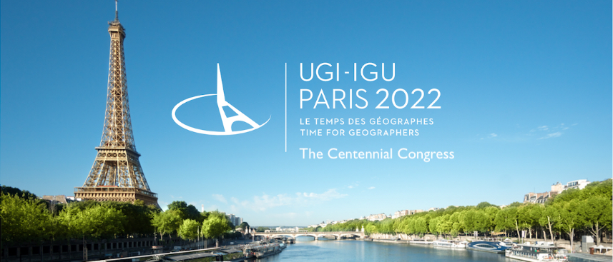
3. Reviewing 2022 activities (so far)
One single (but big!) activity:
12 special sessions / 33 slots / 131 papers
Several new conveners – A big thank
A huge thank to Chia-Lin Chen!

Slide 7
3. Reviewing 2022 activities (so far)
In terms of contents:
Nice range of topics and of scales
Recall Karen Lucas: “What does transport geography add to transport studies?” (The Brian Hoyle Annual Lecture in Transport Geography, 2019 RGS-IBG Annual International Conference, London), which should be our guideline

Slide 8
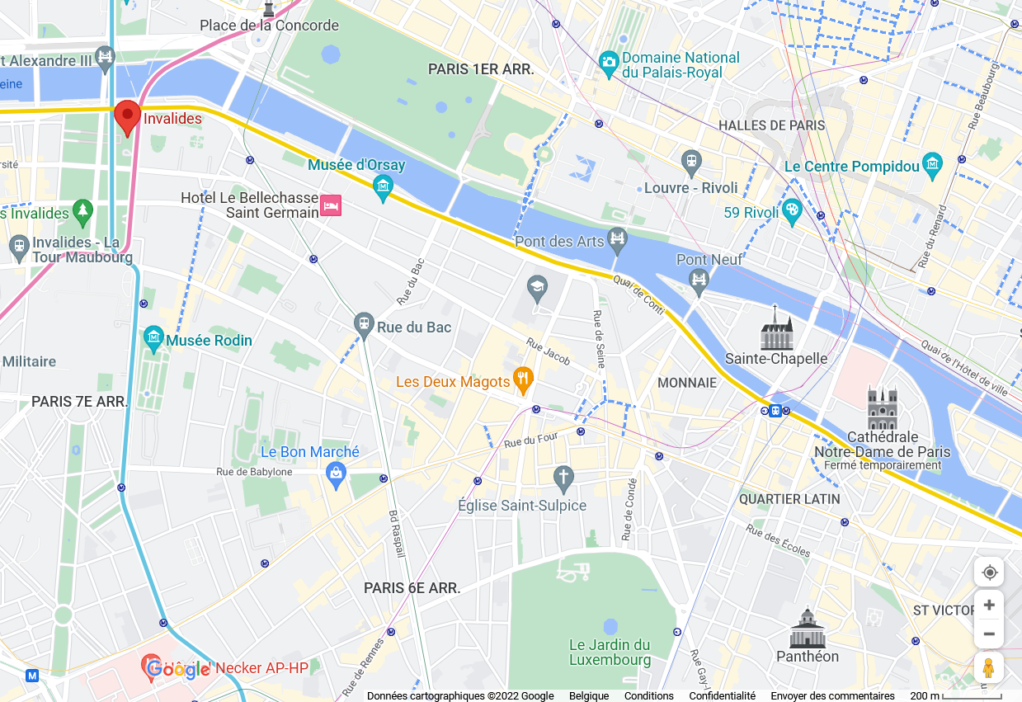
3. Reviewing 2022 activities (so far)
Informal evening on Wed!
From 8pm at Rosa Bonheur sur Seine – Drinks, light meals and pizzas + DJ set
Directions: see https://g.page/RosaSeine?share

Slide 9
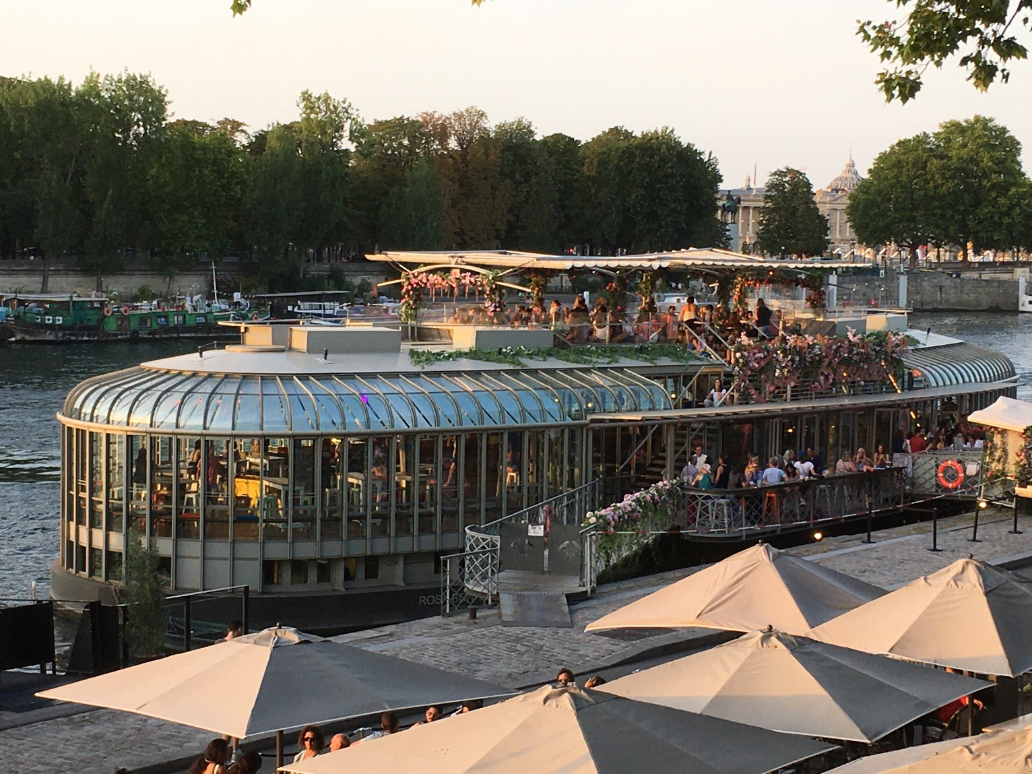
3. Reviewing 2022 activities (so far)
Informal evening on Wed!
From 8pm at Rosa Bonheur sur Seine – Drinks, light meals and pizzas + DJ set
Directions: see https://g.page/RosaSeine?share

Slide 10

4. T&G Commission Travel Grants giving (by A. Goetz)
Scheme:
  Travel grants offered to early-career talents and to colleagues from developing countries
  Applicants shall present at the IGU conference and shall demonstrate the added value of their attendance beyond presenting a paper
  $600 to $1000 subject to rationale and distance (subject to changes over time depending on our future budget)

Slide 11
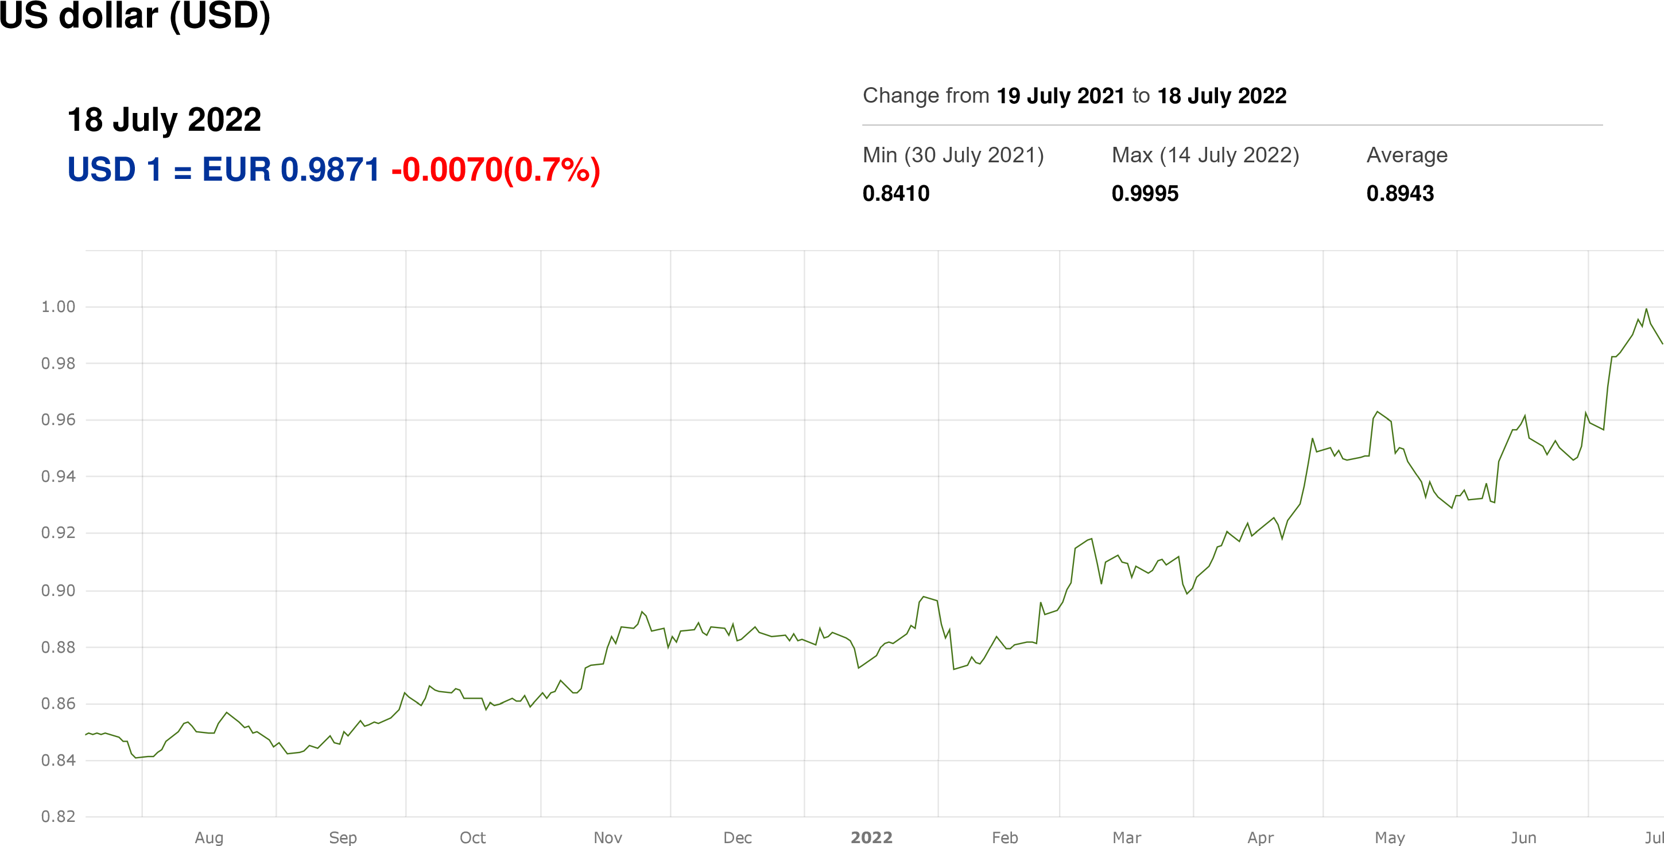
4. T&G Commission Travel Grants giving (by A. Goetz)

Slide 12
4. T&G Commission Travel Grants giving (by A. Goetz)
Laureates:
From the 34th IGC Conference (Istanbul/online, 2020):
  Amparo MOYANO, University of Castilla-La Mancha, Spain
2022 laureates:
  Surjaa CHAKRAVARTI, Jawaharlal Nehru University, New Delhi, India
  Karyn SCERRI, University of Malta, Malta
  Arthur STARZEC, University College London, UK
  Elda Vivianna TANCREDI, National University of Luján, Buenos Aires, Argentina

Slide 13
5. Perspectives for 2023 onwards
Themed sessions are key aspect of our Commission’s live
Everyone can propose themed sessions within both IGU/non-IGU scientific events, including:
  (IGU Thematic Conference 24-25 November 2022 Mahendragarh, India)
  IGU Thematic Conference March 2023 Osaka, Japan
  IGU Thematic Conference June/July 2023 Milan, Italy
  IGU Thematic Conference 20-23 August 2023 Mexico City, Mexico
  IGU Thematic Conference 3-5 June 2024 Quito, Ecuador
  35th IGC 25-30 August 2024 Dublin, Ireland
  IGU Regional Conference 17th-21st August 2026 Istanbul, Turkey
  36th IGC 9-14 July 2028 Melbourne, Australia
  Others such as AAG, EUGEO, ERSA, NECTAR, RGS-IGB, RSA, etc.

Slide 14
5. Perspectives for 2023 onwards
Other activities are also welcome, including:
  Field trips
  …
T&G Commission sponsoring: please contact frederic.dobruszkes@ulb.be

Slide 15

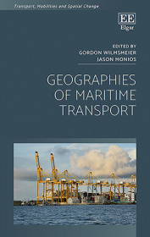
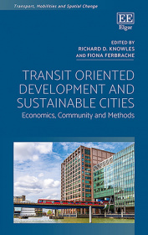
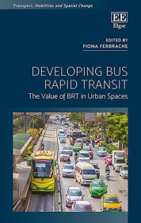
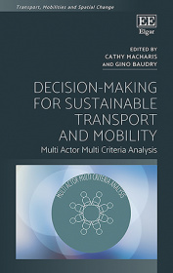
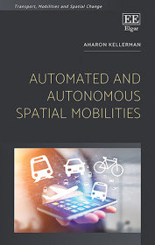
6. Edward Elgar Book series: Transport, Mobilities & Spatial Change
Series editors: Richard D. Knowles & Markus Hesse
Published in association with the Transport Geography Research Group of the Royal Geographical Society with the Institute of British Geographers
Two ongoing titles:
  Collaborative Transport Governance: Processes, Structures, Goals and Ambition by Kate Pangbourne
  Planning High-speed Rail for Territorial Transformation: A Comparative Perspective by Chia-Lin Chen
R.D.Knowles@salford.ac.uk

Slide 16
7. Any other business
More information at https://igu-transport.org
Anything else?

Slide 17
Transport & Geography Commission
https://igu-transport.org
IGU Transport & Geography Commission’s business meeting
– Everyone’s welcome!
July 19, 2022
Paris

